Slide 1
Early Help:
Outcomes and Plans Workshop
Need
Outcome
Plan

Slide 2
Notes:
Introduction of trainers
House keeping – fire, toilets, breaks, mobile phones
Confidentiality and safe learning environment

Slide 3
Outcomes of the workshop:
Participants will have an understanding of the importance of outcomes for families
Participants will have an the knowledge and understanding to be able to write outcomes and SMART plans
Participants will have applied skills learnt to current cases.

Slide 4
Ice breaker
Notes:
Language and assumptions

Slide 5
Outcomes - common definition
‘Benefit or difference made to an individual as a result of an intervention’
They do not include outputs (numbers) or services, these belong in the plan.
e.g. Sue will have visited the benefit office three times. This example is about services rather than what Sue is gaining.

Slide 6
One of the main difficulties we have when developing outcomes is our tendency to embed the solution into the outcome.

Slide 7
Need
Outcome
Plan

Slide 8
Needs:
No mention of services
Clear
Concise
What needs to change
What strengths there are
Rationale for the need
Named
Factual, judgment free
Linked to the RAG
Linked to the threshold language.

Slide 9
Outcomes:
No mention of services
SMART
Clear
Linked to needs
Positive wording
Purposeful
Appropriate language
Named
Objective

Slide 10
Plan:
Achieve the outcomes – direct link
SMART
Named
Appropriate language
Individual
Who, what, where, when

Slide 11
Top tips
When writing your outcome you may find it helpful to do the following…..
Write your outcome as though it has already been achieved-it makes it more compelling
Write it as positively moving towards something you want to achieve rather than away from something you want to avoid

Slide 12
Think about
If you got your outcome, what would it…
Give you?
Do for you?
Make possible for you?

Slide 13
What would that:
Give you?
Time with a speech therapist
Do for you?
Help me be more easily understood by my friends
Make possible for you?
Friendship
Social activities
Feel confident around other people
5 hours of speech and language therapy
Notes:
Vicky

Slide 14
So what is the real outcome?
I am understood by my friends and I can play with them at the after school club everyday.
Notes:
Vicky

Slide 15
So what possible actions on the plan might there be?
Speech and language therapy
Help in the classroom including my friends
Social activities outside of school
Differentiated curriculum
My friends learn my signs
Notes:
Vicky

Slide 16
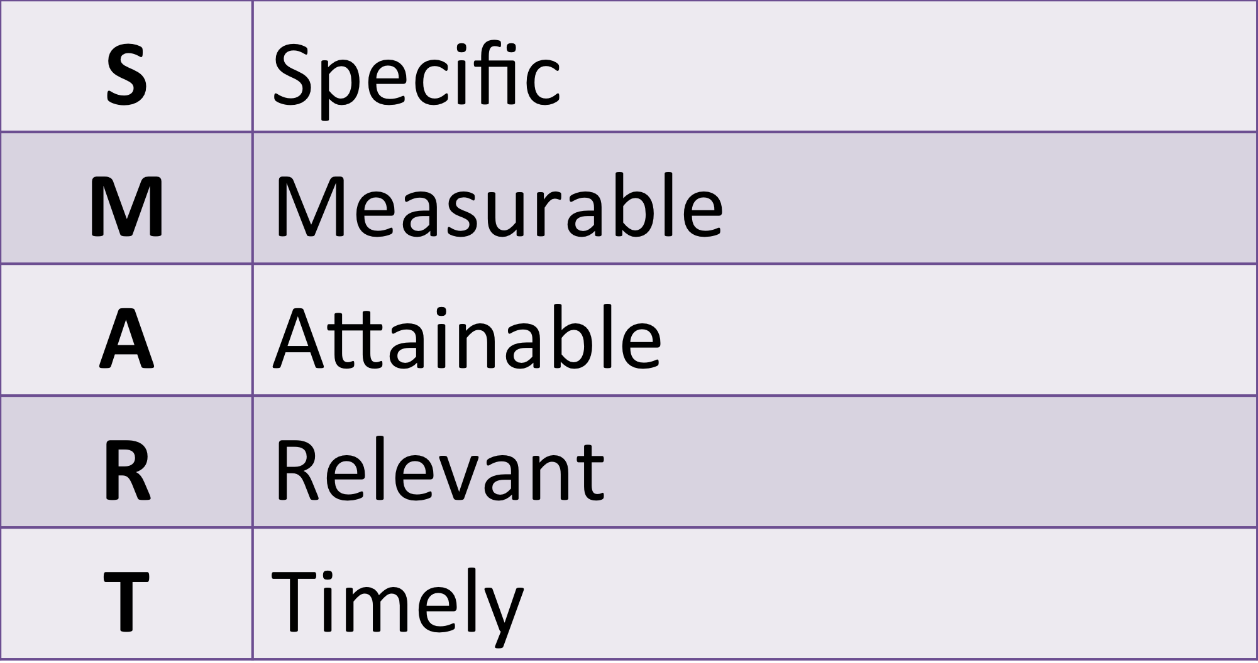
SMART Plans

Slide 17
Plans
When putting a plan together, think about the “quick wins”. The feedback from the Government’s “Troubled Families” agenda from parents was that they wanted things that were more easily achievable at the top of the plan, as, if they could achieve these, it motivated them to address the more challenging issues.

Slide 18
Case Study Activity
In 2 groups:
Identify all needs
Write outcomes based on needs
Create a SMART plan for one outcome

Slide 19
Application: Now apply your learning to one of your own cases

Slide 20
Evaluation Please reflect on today and be honest, so we can improve.

